Slide 1
MySQL supports two kinds of aliases which are known as column alias and table alias.
Sometimes, column names are so technical that make the query’s output very difficult to understand. To give a column a descriptive name, you can use a column alias.
The following statement illustrates how to use the column alias:
SELECT
[column_1 | expression] AS descriptive_name
FROM table_name;
To assign an alias to a column, you use the AS keyword followed by the alias. If the alias contains spaces, you must quote it as the following:
SELECT
[column_1 | expression] AS `descriptive name`
FROM
table_name;
Because the AS keyword is optional, you can omit it in the statement. Note that you can also give an expression an alias.
Observe there is a space so you need to put single quotes’

Slide 2
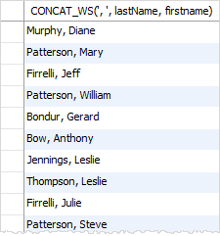
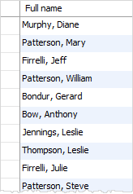
The following query selects the first names and last names of employees. It uses the CONCAT_WS() function to concatenate first name and last name into full name.
SELECT
CONCAT_WS(', ', lastName, firstname)
FROM
employees;
The column heading is quite difficult to read. To solve this, you can assign the column heading of the output a column alias as shown in the following query:
SELECT
CONCAT_WS(', ', lastName, firstname) AS `Full name`
FROM employees;
In MySQL, you can use the column alias in the ORDER BY, GROUP BY and HAVINGclauses to refer to the column.
The following query uses the column alias in the ORDER BY clause to sort the employee’s full names alphabetically:
SELECT CONCAT_WS(', ', lastName, firstname) `Full name`
FROM employees ORDER BY `Full name`;

Slide 3
column aliases
table alias
This query shows how to assign the employees table alias as e:
SELECT * FROM employees e;
The following statement selects the orders whose total amount are greater than 60000. It uses column aliases in GROUP BY and HAVING clauses.
SELECT
orderNumber `Order no`,
SUM(priceEach * quantityOrdered) total
FROM
orderDetails
GROUP BY
`Order no`
HAVING
total > 60000;
Once a table is assigned an alias, you can refer to the table columns using the following syntax:
table_alias.column_name
For example:
SELECT
e.firstName,
e.lastName
FROM
employees e
ORDER BY e.firstName;

Slide 4
Notice that you cannot use a column alias in the WHERE clause. The reason is that when MySQL evaluates the WHERE clause, the values of columns specified in the SELECT clause is not be evaluated yet.
SELECT name, salary * 1.1 AS new_salary
FROM employees
WHERE new_salary > 50000; -- ❌ This won't work because new_salary is an alias.
SELECT name, salary * 1.1 AS new_salary
FROM employees
WHERE salary * 1.1 > 50000; -- ✅ Works, but can be repetitive.

Slide 5
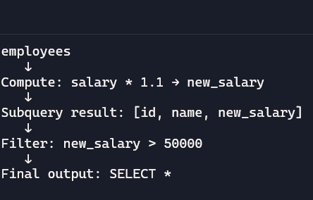
🧠 Logical Execution Order
FROM clause (inner query)
The employees table is scanned.
Rows are retrieved with columns: id, name, and salary.
SELECT clause (inner query)
The expression salary * 1.1 AS new_salary is evaluated.
A derived table (subquery) is formed with id, name, and new_salary.
FROM clause (outer query)
The subquery result is treated as a temporary table named subquery.
WHERE clause (outer query)
The filter new_salary > 50000 is applied to the rows from the subquery.
SELECT clause (outer query)
All columns (*) from the filtered subquery are returned.
🔍 Visualizing It
Here’s a simplified diagram of the flow:
When column alias in where clause works?
SELECT * FROM (
SELECT id, name, salary * 1.1 AS new_salary
FROM employees
) AS subquery
WHERE new_salary > 50000;

Slide 6
Alias in Having Clause
SELECT department, AVG(salary) AS avg_salary
FROM employees
GROUP BY department
HAVING avg_salary > 50000;
-- ✅ Works because avg_salary is defined before HAVING is evaluated.
🧠 Logical Execution Order of SQL Query
FROM clause: • The table is scanned first. • All rows are retrieved.
GROUP BY clause • Rows are grouped by the column. •Each group now represents one department.
SELECT clause •For each group, is calculated. •The result is aliased as .
HAVING clause •The condition is applied after aggregation. •Only groups (departments) with average salary above 50,000 are retained.
Final Output: •The query returns and for qualifying groups.

Slide 7
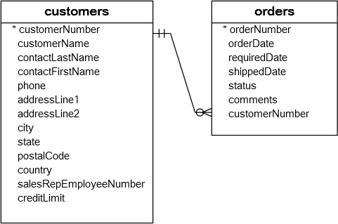
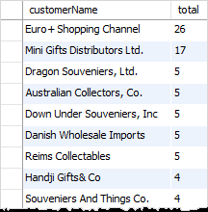
The table aliases are often used in the statement that contains INNER JOIN, LEFT JOIN, RIGHT JOIN clauses and in subqueries.
Let’s look at the customers and orders tables:
Both tables have the same column name:customerNumber.Without using the table alias to qualify the customerNumber column, you will get an error message like:
Error Code: 1052. Column 'customerNumber' in on clause is ambiguous
To avoid this error, you use table alias to qualify the customerNumber column:
SELECT customerName,
COUNT(o.orderNumber) total
FROM customers c
INNER JOIN orders o ON c.customerNumber = o.customerNumber
GROUP BY
customerName
ORDER BY
total DESC;
The query above selects customer name and the number of orders from the customers and orders tables. It uses c as a table alias for the customers table and o as a table alias for the orders table. The columns in the customers and orders tables are referred to via the table aliases.

Slide 8
If you do not use the alias in the query above, you have to use the table name to refer to its columns, which makes the query lengthy and less readable as the following:
SELECT customers.customerName,
COUNT(orders.orderNumber) total
FROM customers
INNER JOIN orders ON customers.customerNumber = orders.customerNumber GROUP BY customerName
ORDER BY total DESC

Slide 9
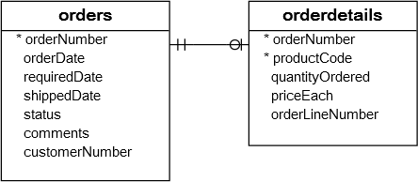
Why Joins
A relational database consists of multiple related tables linking together using common columns which are known as foreign key columns. Because of this, data in each table is incomplete from the business perspective.
For example, in the sample database, we have the orders and orderdetails tables that are linked using the orderNumber column:
MySQL Transaction: orders & orderDetails Tables
To get complete orders’ information, you need to query data from both orders and orderdetails tables.
That’s why joins come into the play.
A join is a method of linking data between one (self-join) or more tables based on values of the common column between the tables.
MySQL supports the following types of joins:
Inner join
Left join
Right join
Cross join
The join clause is used in the SELECT statement appeared after the FROM clause.
Note that MySQL hasn’t supported the FULL OUTER JOIN yet.

Slide 10
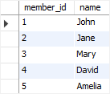

Inner join data planning
Second, insert some rows into the tables members and committees :
INSERT INTO members(name)
VALUES('John'),('Jane'),('Mary'),('David'),('Amelia');
INSERT INTO committees(name)
VALUES('John'),('Mary'),('Amelia'),('Joe');
First, create two tables called members and committees:
CREATE TABLE members (
member_id INT AUTO_INCREMENT,
name VARCHAR(100),
PRIMARY KEY (member_id)
);
CREATE TABLE committees (
committee_id INT AUTO_INCREMENT,
name VARCHAR(100),
PRIMARY KEY (committee_id)
);
Third, query data from the tables members and committees:
SELECT * FROM members;
SELECT * FROM committees;
Some members are the committee members, and some are not. On the other hand, some committee members are in the members table, some are not.

Slide 11
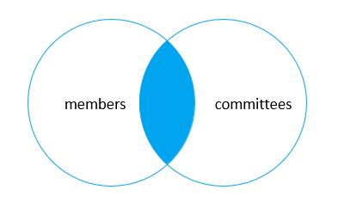

MySQL INNER JOIN clause
The following shows the basic syntax of the inner join clause that joins two tables table_1 and table_2:
SELECT column_list
FROM table_1
INNER JOIN table_2 ON join_condition;
If the join condition uses the equal operator (=) and the column names in both tables used for matching are the same, you can use the USING clause instead:
SELECT column_list
FROM table_1
INNER JOIN table_2 USING (column_name);
The inner join clause joins two tables based on a condition which is known as a join predicate.
The inner join clause compares each row from the first table with every row from the second table. If values in both rows cause the join condition evaluates to true, the inner join clause creates a new row whose column contains all columns of the two rows from both tables and include this new row in the final result set. In other words, the inner join clause includes only rows whose values match.
The following statement finds members who are also the committee members:
SELECT m.member_id, m.name member,
c.committee_id, c.name committee
FROM members m
INNER JOIN committees c
ON c.name = m.name;
Because the name columns are the same in both tables, you can use the USING clause as shown in the following query:
SELECT m.member_id, m.name member,
c.committee_id, c.name committee
FROM members m INNER JOIN committees c USING(name);
In this example, the inner join clause used the values in the name columns in both tables members and committees to match.

Slide 12
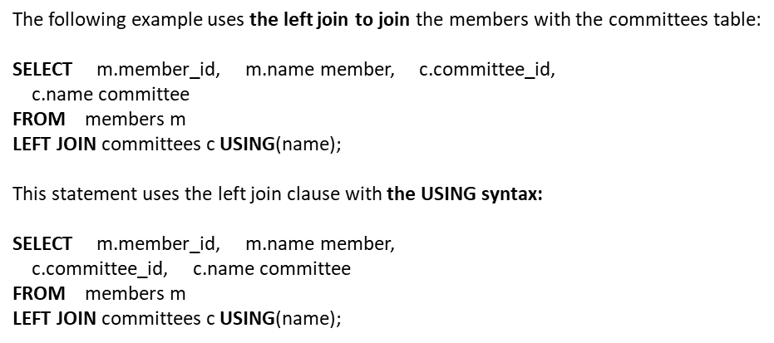

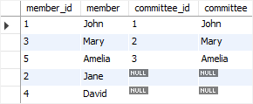
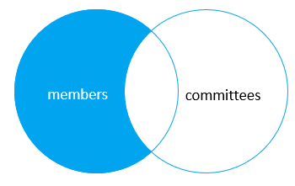
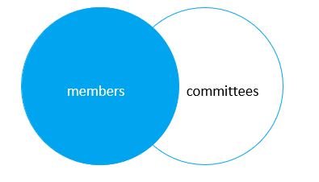
MySQL LEFT JOIN clause
MySQL LEFT outer JOIN clause
The left join selects data starting from the left table. For each row in the left table, the left join compares with every row in the right table. If the values in the two rows cause the join condition evaluates to true, the left join creates a new row whose columns contain all columns of the rows in both tables and includes this row in the result set
if the values in the two rows are not matched, the left join clause still creates a new row whose columns contain columns of the row in the left table and NULL for columns of the row in the right table.
In other words, the left join selects all data from the left table whether there are matching rows exist in the right table or not. In case there is no matching rows from the right table found, NULLs are used for columns of the row from the right table in the final result set.
SELECT
m.member_id,
m.name member,
c.committee_id,
c.name committee
FROM
members m
LEFT JOIN committees c USING(name)
WHERE c.committee_id IS NULL;

Slide 13

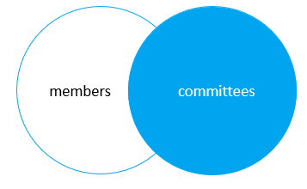

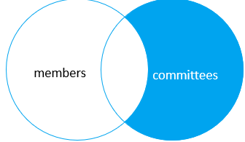
MySQL RIGHT JOIN clause
Here is the syntax of the right join:
The right join clause is similar to the left join clause except that the treatment of tables is reversed. The right join starts selecting data from the right table instead of the left table.
The right join clause selects all rows from the right table and matches rows in the left table. If a row from the right table does not have matching rows from the left table, the column of the left table will have NULL in the final result set.
This statement uses the right join to join the members and committees tables:
SELECT m.member_id, m.name member,
c.committee_id, c.name committee
FROM members m
RIGHT JOIN committees c on c.name = m.name;
The following statement uses the right join clause with the USING syntax:
SELECT m.member_id, m.name member, c.committee_id,
c.name committee
FROM members m
RIGHT JOIN committees c USING(name);
To find the committee members who are not in the members table, you use this query:
SELECT m.member_id, m.name member, c.committee_id,
c.name committee
FROM members m
RIGHT JOIN committees c USING(name)
WHERE m.member_id IS NULL;
MySQL RIGHT outer JOIN clause

Slide 14
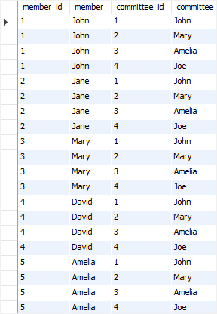
MySQL CROSS JOIN clause
The following shows the basic syntax of the cross join clause:
SELECT select_list
FROM table_1
CROSS JOIN table_2;
This example uses the cross join clause to join the members with the committees tables:
SELECT m.member_id, m.name member,
c.committee_id, c.name committee
FROM members m
CROSS JOIN committees c;
Unlike the inner join, left join, and right join, the cross join clause does not have a join condition.
The cross join makes a Cartesian product of rows from the joined tables. The cross join combines each row from the first table with every row from the right table to make the result set.
Suppose the first table has n rows and the second table has m rows. The cross join that joins the first with the second table will return nxm rows.
The cross join is useful for generating planning data. For example, you can carry the sales planning by using the cross join of customers, products, and years.

Slide 15
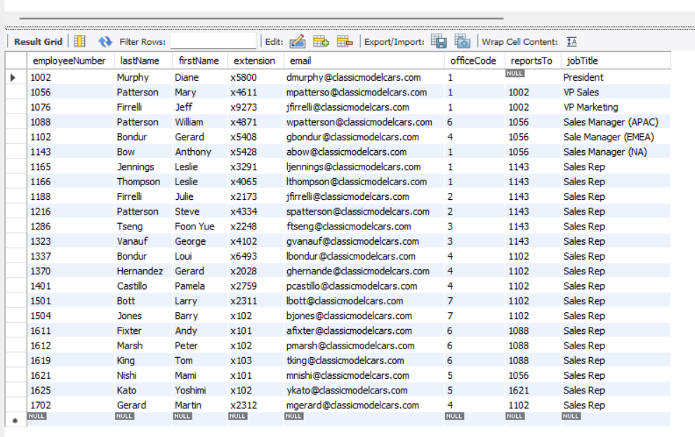
Diagram of hierarchy
President
1002
Vp Sales
1056
Vp Marketing 1076
Sales Manger
1102
1088
1143
Bondur, Loui
Hernandez, Gerard
Castillo, Pamela
Bott, Larry
Jones, Barry
Gerard, Martin
Jennings, Leslie
Thompson, Leslie
Firrelli, Julie
Patterson, Steve
Tseng, Foon Yue
Vanauf, George
Fixter, Andy
Marsh, Peter
King, Tom

Slide 16
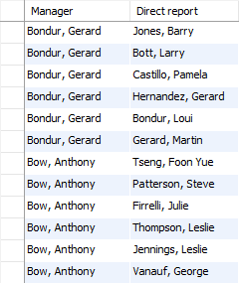
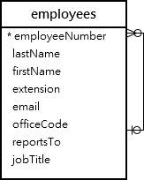
MySQL self join
1) MySQL self join using INNER JOIN clause
To get the whole organization structure, you can join the employees table to itself using the employeeNumber and reportsTo columns. The table employees has two roles: one is the Manager and the other is Direct Reports.
SELECT
CONCAT(m.lastName, ', ', m.firstName) AS Manager,
CONCAT(e.lastName, ', ', e.firstName) AS 'Direct report'
FROM
employees e
INNER JOIN employees m ON
m.employeeNumber = e.reportsTo
ORDER BY
Manager;
The self join is often used to query hierarchical data or to compare a row with other rows within the same table.
To perform a self join, you must use table aliases to not repeat the same table name twice in a single query. Note that referencing a table twice or more in a query without using table aliases will cause an error.
Let’s take a look at the employees table in the sample database.
The table employees stores not only employees data but also the organization structure data. The reportsto column is used to determine the manager id of an employee
The output only shows the employees who have a manager. However, you don’t see the President because his name is filtered out due to the INNER JOIN clause.

Slide 17
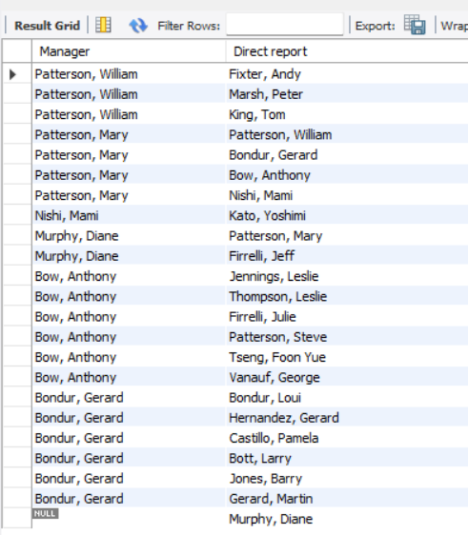
SELECT CONCAT(m.lastname, ', ', m.firstname) AS 'Manager', CONCAT(e.lastname, ', ', e.firstname) AS 'Direct report'FROM employees eLEFT JOIN employees m ON m.employeeNumber = e.reportstoORDER BY manager DESC;
What if I want “Top Manger” value if NULL
SELECT IFNULL(NULL, 'No Value'); -- Returns 'No Value'
SELECT IFNULL('Hello', 'Fallback'); -- Returns 'Hello'
SELECT IFNULL(NULL, 100); -- Returns 100

Slide 18


MySQL self join
SELECT c1.city, c1.customerName FROM customers c1 ORDER BY c1.city;
3) Using MySQL self join to compare successive rows
By using the MySQL self join, you can display a list of customers who locate in the same city by joining the customers table to itself.
SELECT c1.city, c1.customerName,
c2.customerName
FROM customers c1
INNER JOIN customers c2 ON
c1.city = c2.city
AND c1.customername > c2.customerName
ORDER BY c1.city;
In this example, the table customers is joined to itself using the following join conditions:
c1.city = c2.city makes sure that both customers have the same city.
c.customerName > c2.customerName ensures that no same customer is included.

Slide 19
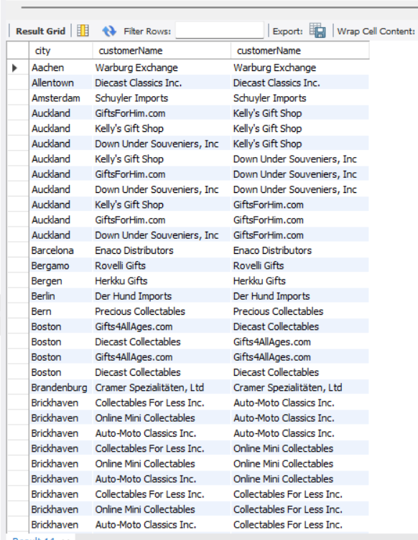
SELECT c1.city, c1.customerName, c2.customerNameFROM customers c1INNER JOIN customers c2 ON c1.city = c2.city ORDER BY c1.city;

Slide 20
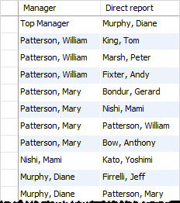
2) MySQL self join using LEFT JOIN clause
The President is the employee who does not have any manager or the value in the reportsTo column is NULL .
The following statement uses the LEFT JOIN clause instead of INNER JOIN to include the President:
SELECT
IFNULL(CONCAT(m.lastname, ', ', m.firstname),
'Top Manager') AS 'Manager',
CONCAT(e.lastname, ', ', e.firstname) AS 'Direct report'
FROM
employees e
LEFT JOIN employees m ON
m.employeeNumber = e.reportsto
ORDER BY manager DESC;
If NULL display ‘Top Manager’

Slide 21
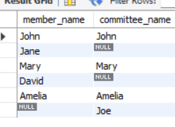
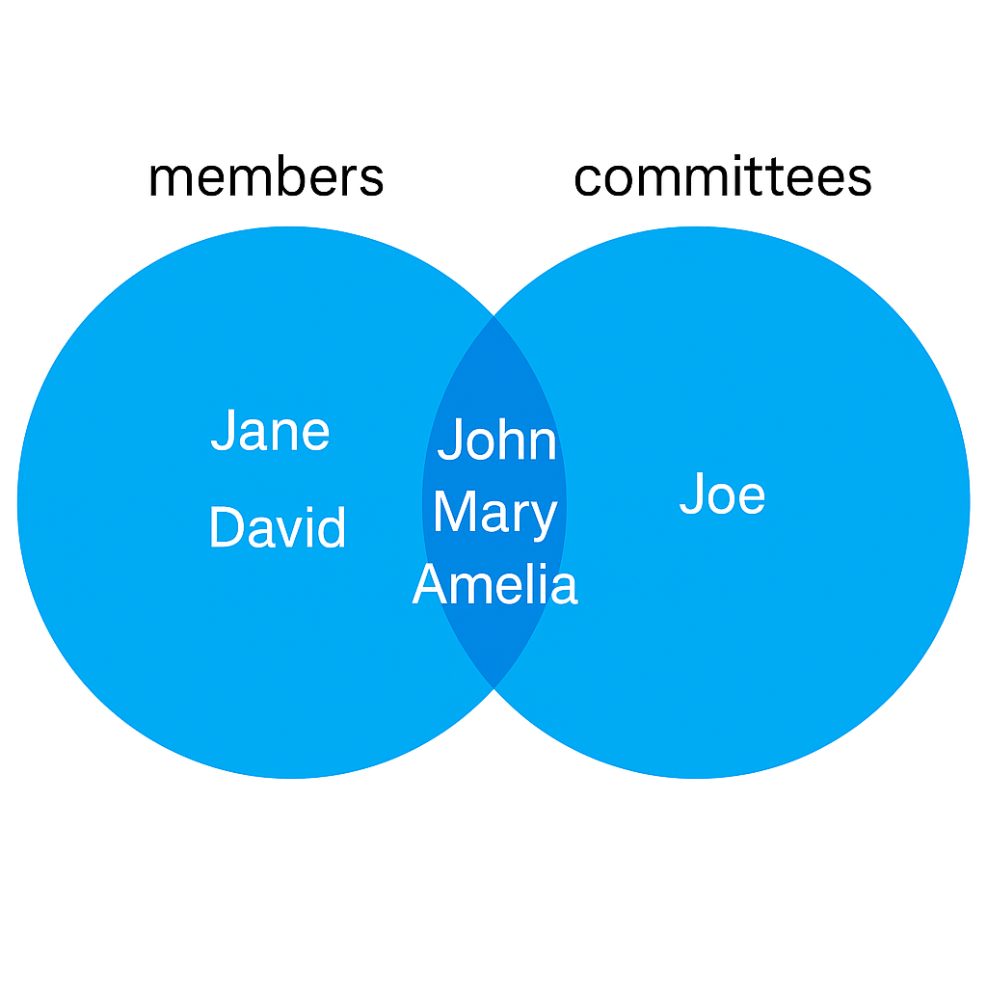
Since MySQL doesn’t support FULL JOIN natively, we can emulate it by using a LEFT JOIN, a RIGHT JOIN, and combining the results with a UNION
SELECT members.name AS member_name, committees.name AS committee_name
FROM members
LEFT JOIN committees
ON members.name = committees.name
UNION
members.name AS member_name, committees.name AS committee_name
FROM membersRIGHT JOIN committees ON members.name = committees.name;

Slide 22
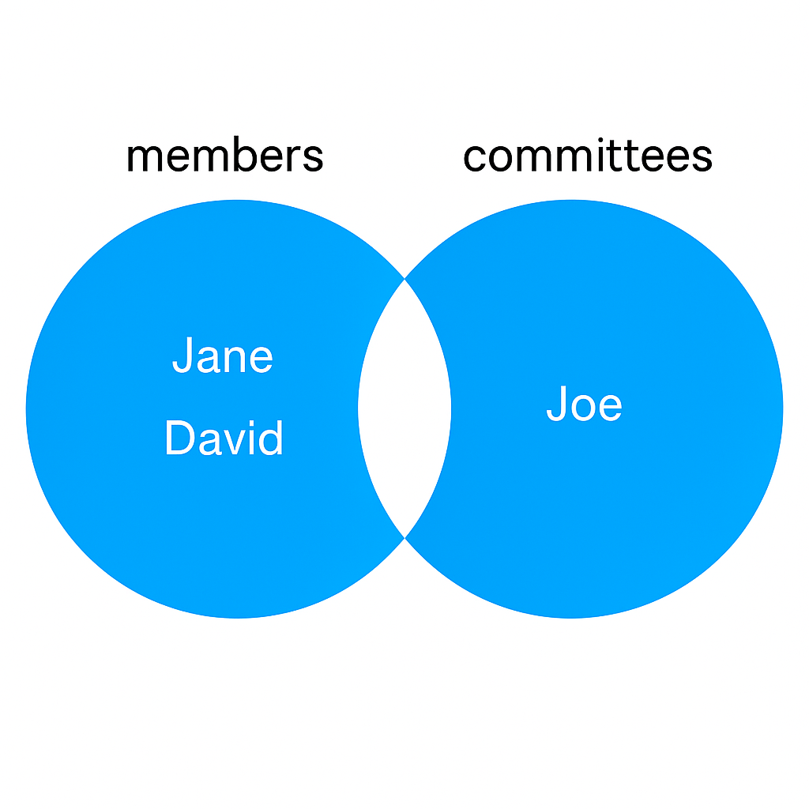
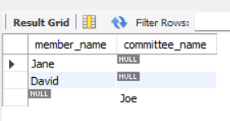
Full outer join
SELECT members.name AS member_name, NULL AS committee_name
FROM members
LEFT JOIN committees
ON members.name = committees.name
WHERE committees.name IS NULL
UNION
SELECT NULL AS member_name, committees.name AS committee_name
FROM membersRIGHT JOIN committees ON members.name = committees.name
WHERE members.name IS NULL;

